Slide 1


Slide 2
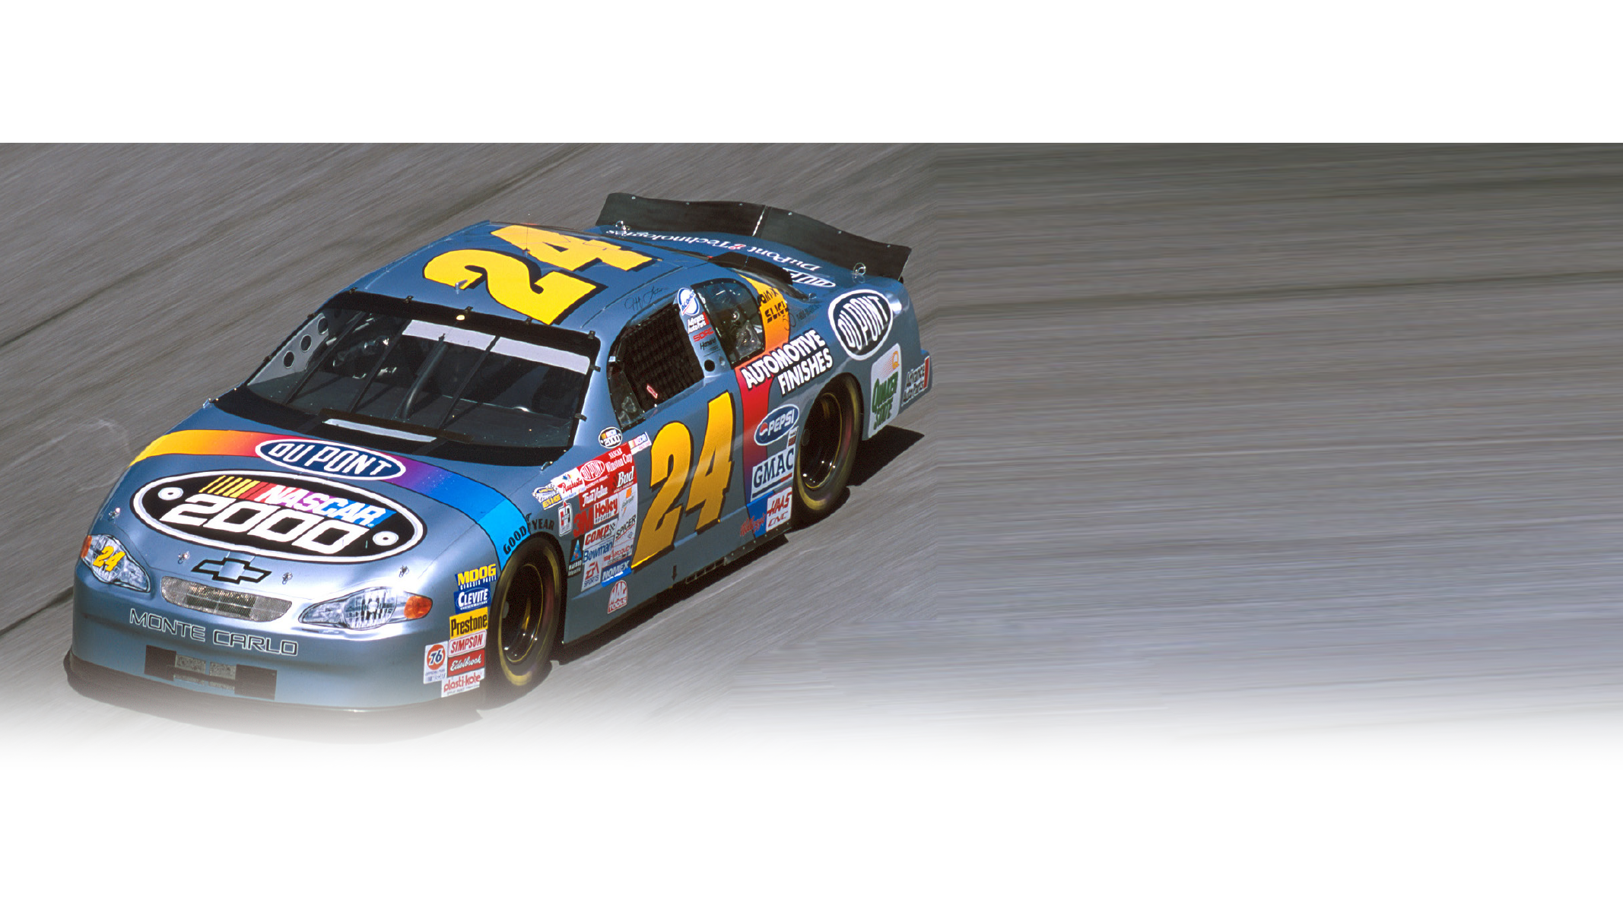


WHAT DO YOU SEE?
Presentation is confidential. 2022©, Mike Mooney, All Rights Reserved.
Notes:
Tell me what you see here …
Facilitator note :: people will call out various elements of the car
Key Message :: We often see the race car as a whole – one piece – it’s the product of the race team!
Isn’t that how we often see and approach our business? What we do is one whole, not see the interconnectedness or impact of our area of work for the entire product our team is developing.

Slide 3
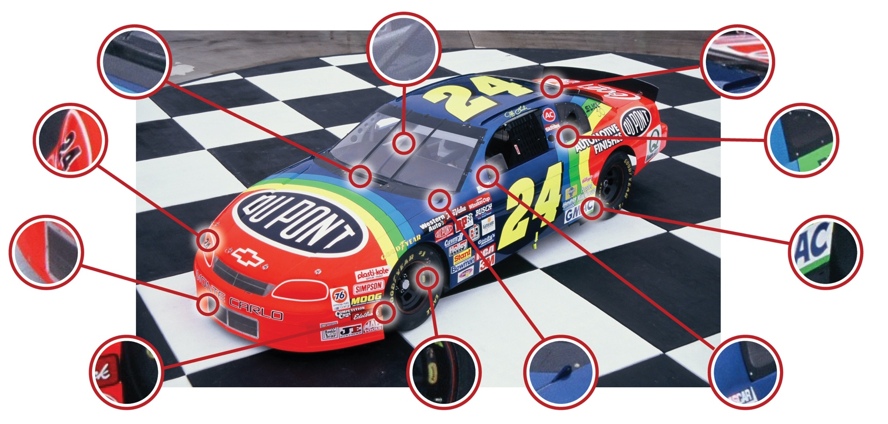
RAY SAW HUNDREDS OF
OPPORTUNITIES TO INNOVATE
Notes:
You see, Ray saw that race and saw hundreds of opportunities to find innovations – he wasn’t looking for one magic bullet – one big swing of the bat!
He knew that there was power in finding 1% gains – more importantly, areas of 1% daily improvement – and he challenged the people on his team to look into their area of work and break it down to find their 1%ers!

Slide 4
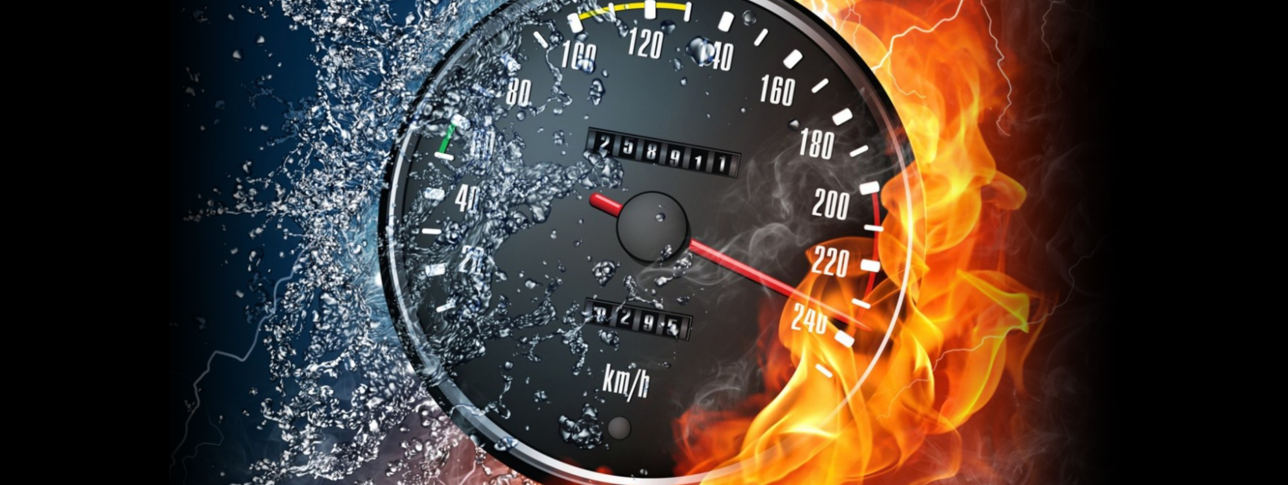
CHALLENGING YOURSELF!
100%
1%
VS
DAILY EFFORT
DAILY IMPROVEMENT
Notes:
Ray knew that 1% daily improvement would out class 100% daily effort!
He looked at 100% daily effort as a given – if you are going to be on a championship-level team, you will bring that level of effort every single day! No questions!
It was table stakes!
Ray wanted his team to challenge themselves each day – because that is what champions do!

Slide 5
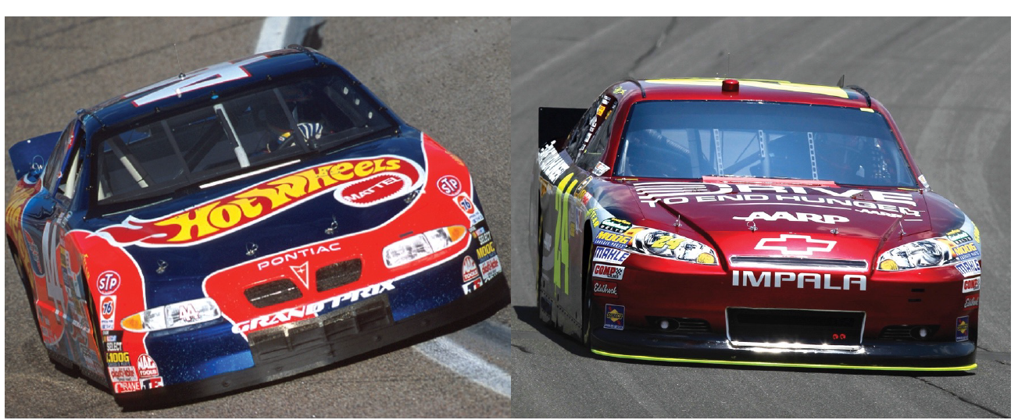

THE HOOD PIN
Notes:
Ray went about challenging his team to find their 1%ers and his aerodynamics team came back with a slight change to the hood pin directions on the car!
The hood pin is vital because it holds the hood down while the cars are exceeding 200mph – yes, it’s important to see when driving that fast!
There are four hood pins that are on the front of every race car

Slide 6
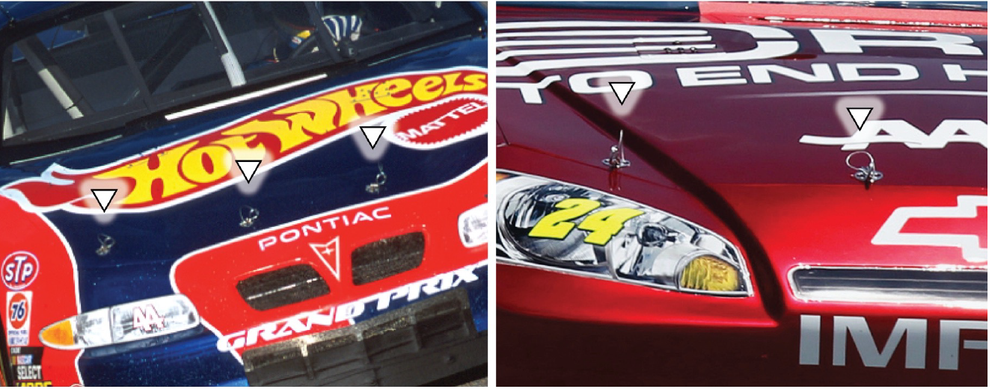
THE HOOD PIN
Notes:
You can see them here!
Now here is the 1%er – traditionally, as see on the left image, the hood pins are positioned horizontally
Ray’s team wondered, “what if we shifted the position to vertical? It would reduce drag over the head and make the car a little more aero friendly.”
So they did!

Slide 7

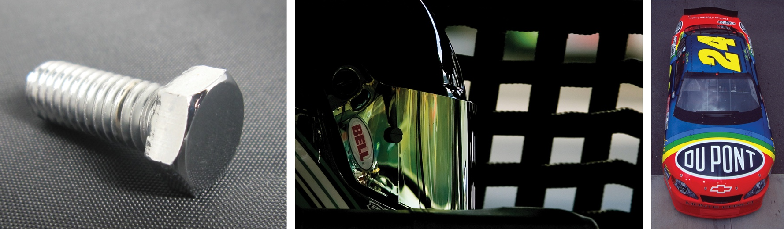

THEY DIDN’T STOP THERE
Presentation is confidential. 2022©, Mike Mooney, All Rights Reserved.
Notes:
They didn’t stop there:
The team began to shave off unused threads on the bolts that delivered pounds of extra weight that was then used by the aerodynamics team
They had window nets made with smaller squares that reduced the amount of air being sucked into the vehicle
These were just a few of the 1%ers that they found and put into play!
Each small, but when piled onto another, it created significant on-track advantages that, along with other competitive innovations, made this team one of the most successful in NASCAR history!

Slide 8

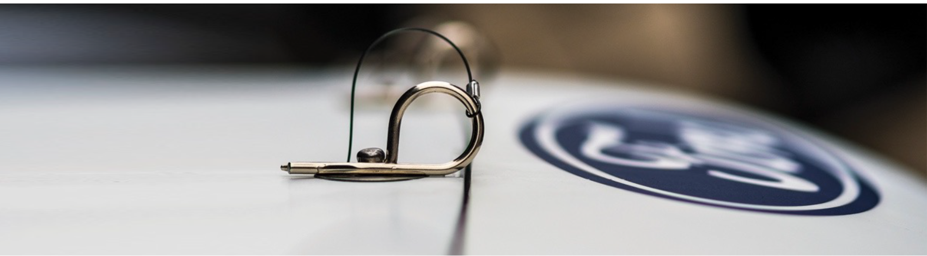

WHAT IS YOUR 1%
What’s your HOOD PIN?
Efficiency & Impact
Presentation is confidential. 2022©, Mike Mooney, All Rights Reserved.
Notes:
So here’s the question for us today – what’s your hoodpin?
Can you think about where just 1% of daily improvement would benefit this team?
Prompt Questions:
What could it be?
If you were to think about revenue generating areas of your business where would 1% daily improvement yield impact?
What if you could generate 1% more in margin?
Facilitator Note :: Begin to write down answers on large pad – these answers could become break-out session topics to address and create plans of action!

Slide 9
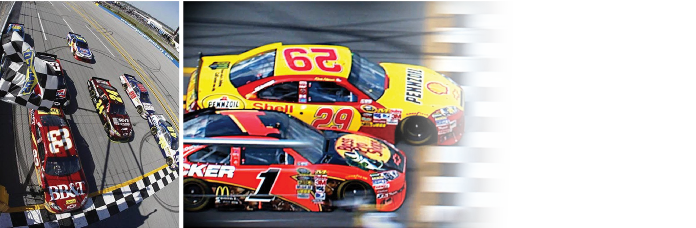
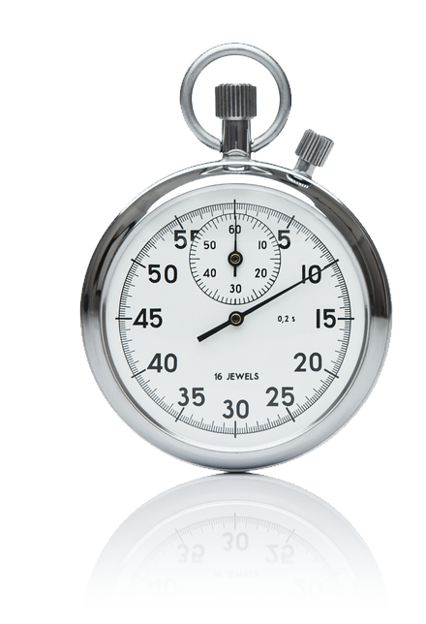
RACING THE CLOCK

Slide 10
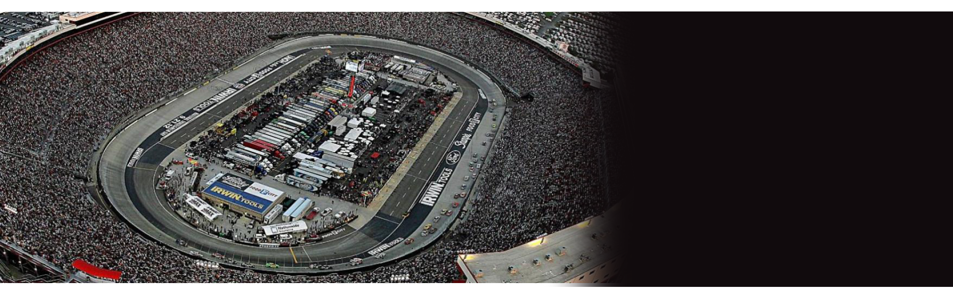

HOW TEAMS FIND 1%
400 MILE RACE?

Slide 11
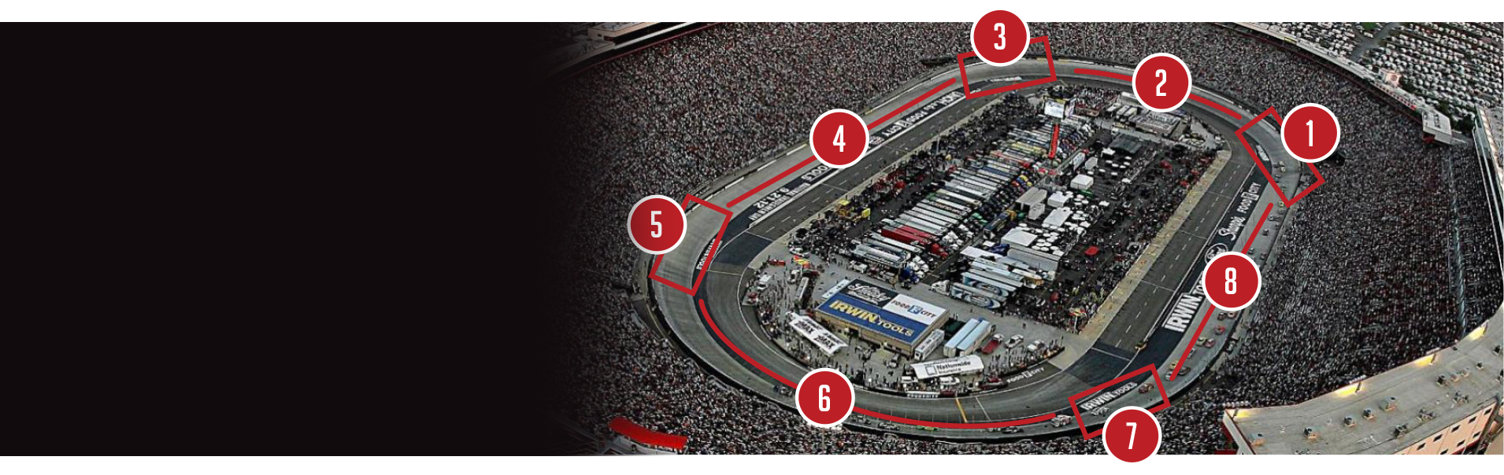
HOW TEAMS FIND 1%
400 MILE PROCESS – EVERY LAP

Slide 12


THE MYTH OF PROGRESS

Slide 13


THE REALITY
Presentation is confidential. 2023©, Mike Mooney, All Rights Reserved.
Notes:
Ray knew that 1% daily improvement would out class 100% daily effort!
He looked at 100% daily effort as a given – if you are going to be on a championship-level team, you will bring that level of effort every single day! No questions!
It was table stakes!
Ray wanted his team to challenge themselves each day – because that is what champions do!

Slide 14


PEAK PERFORMANCE
2ND GEAR!

Slide 15
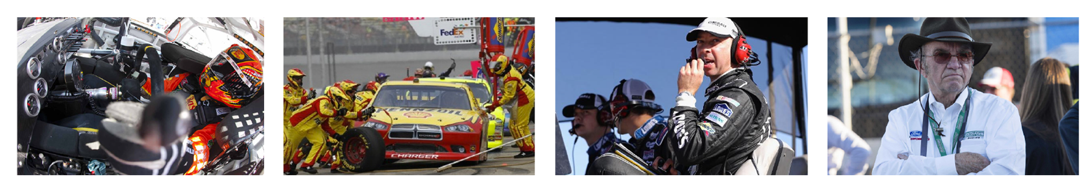

WHO DO YOU THINK HAS THE MOST VITAL JOB?
1
2
3
4

Slide 16
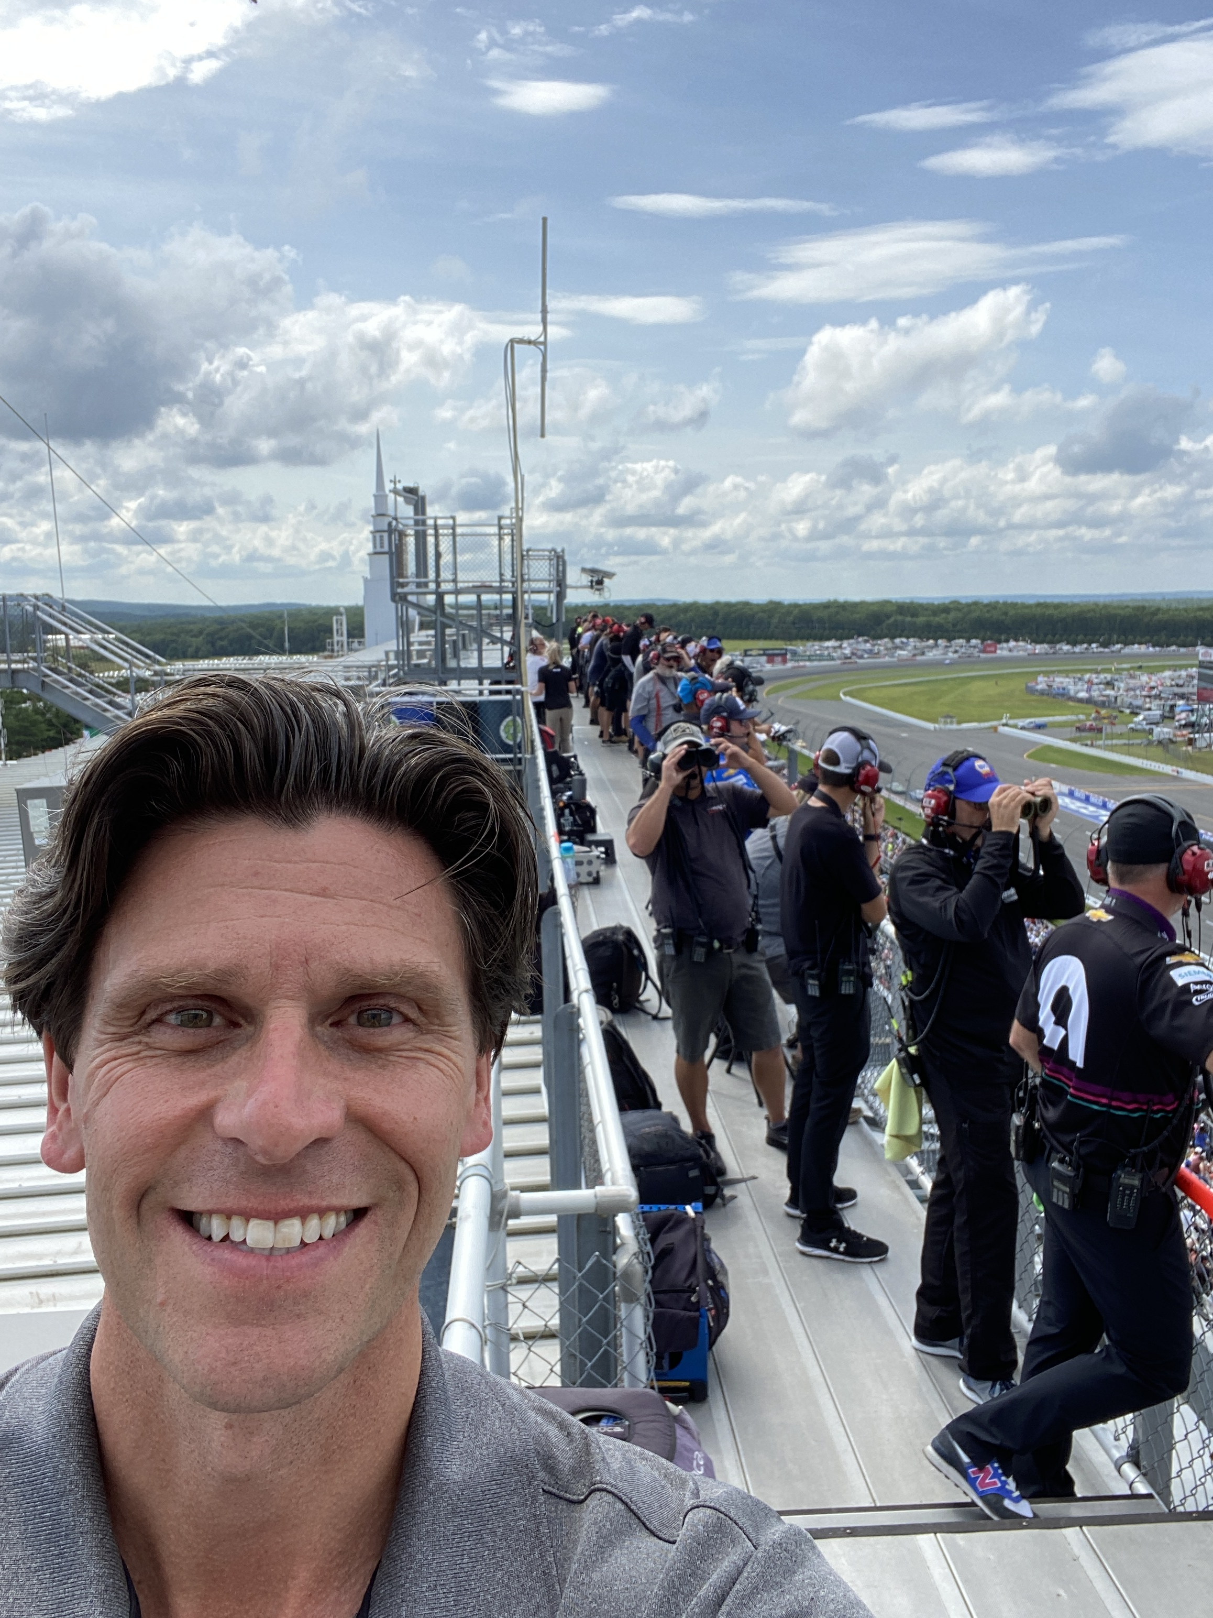
THE SPOTTER
THE SPOTTER

Slide 17
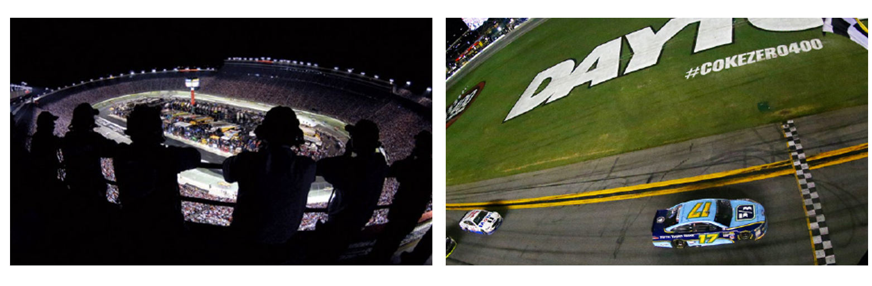
POWERFUL RELATIONSHIPS
“We are a safety device for our drivers. They want to win and it’s our job to help make that happen. In order to do that they have to trust our every word. Its like doing trust falls at 200 miles an hour!”
BRETT GRIFFIN –
NASCAR Spotter
Notes:
They want to win and it’s our job to help make that happen. In order to do that they have to trust our every word. Its like doing trust falls at 200 miles an hour!

Slide 18
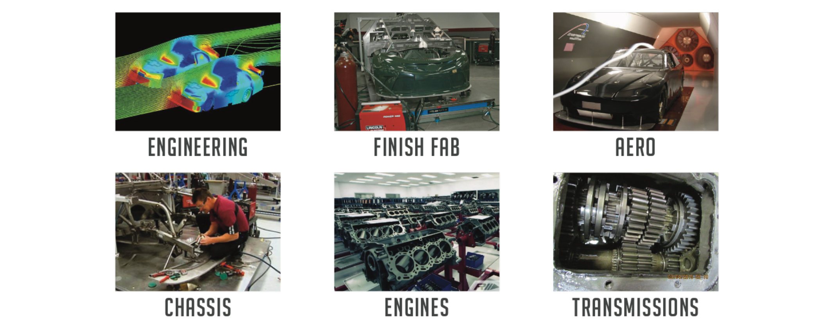
TEAM HANDOFFS AND TRUST

Slide 19
WHERE WERE OUR SPOTTERS?

Slide 20

INTERNAL SPOTTERS?

Slide 21
THE SPOTTER
THE SPOTTER
How Will You Find YOUR BLIND SPOTS?

Slide 22
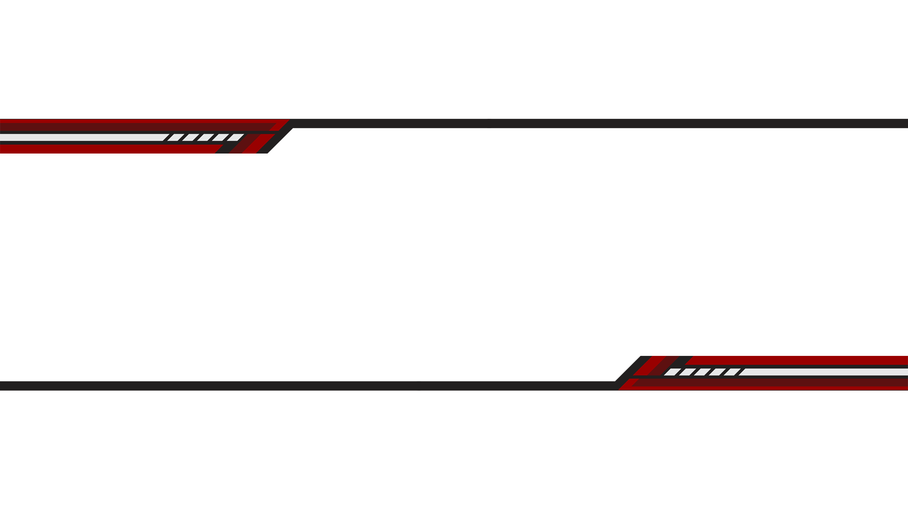
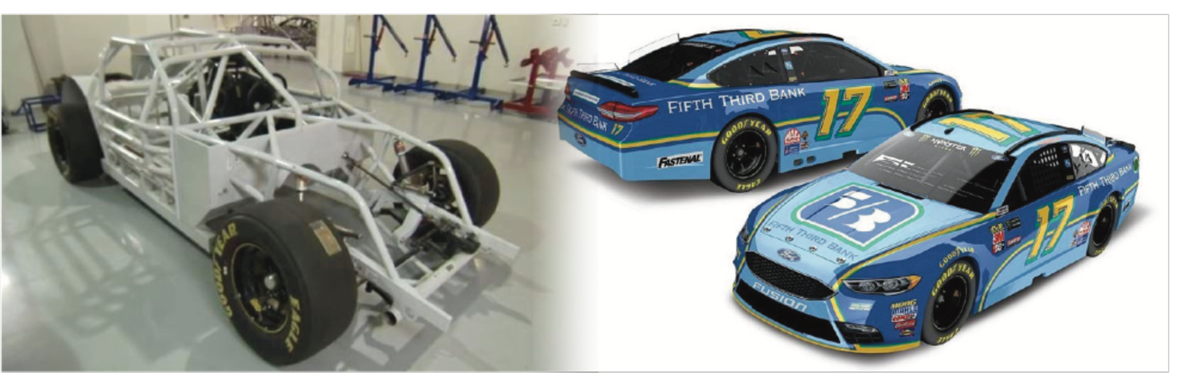
TEAM HAND OFFS AND TRUST
200 pairs of hands + 10 (+) departments = 1 race car

Slide 23
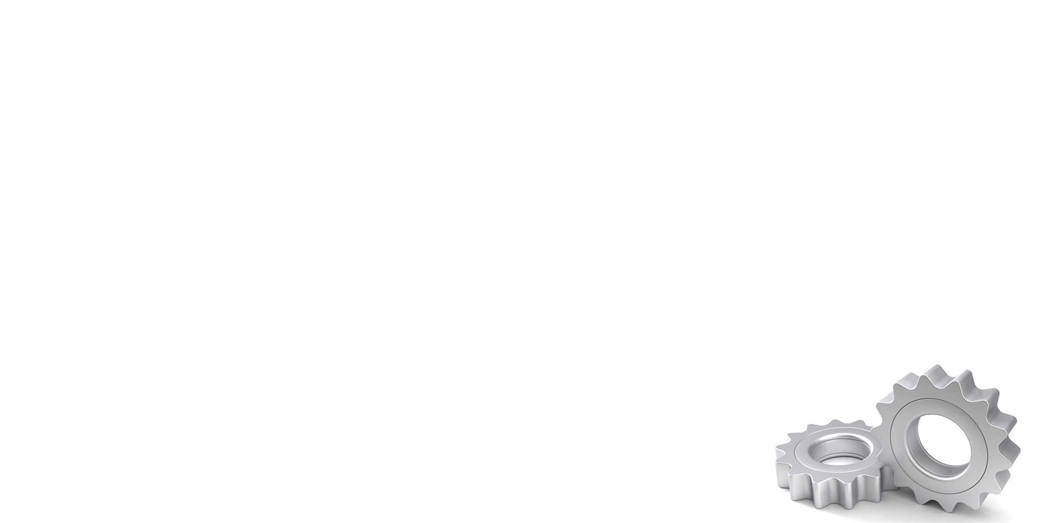

2 KEY COMPONENTS OF TRUST
CHARACTER
COMPETENCE
Motives
Integrity
Intent
History
Skills
Capabilities
Results
History
I trust
the person
I trust what
they can do
Stephen Covey, The Speed of Trust, 2006

Slide 24

2 KEY COMPONENTS OF TRUST
CHARACTER
COMPETENCE
I trust the person
I trust what they can do
Earned Every Day
Re-enforced Every Day
Stephen Covey, The Speed of Trust, 2006

Slide 25


DON’T ROLL THE DICE TO BUILD TRUST
DEPENDABILITY
Honor your commitments
INTEGRITY
Do the right thing
CAPABILITY
Be an expert & have a POV
ENGAGEMENT
Be proactive & act!
Presentation is confidential. 2022©, Mike Mooney, All Rights Reserved.

Slide 26
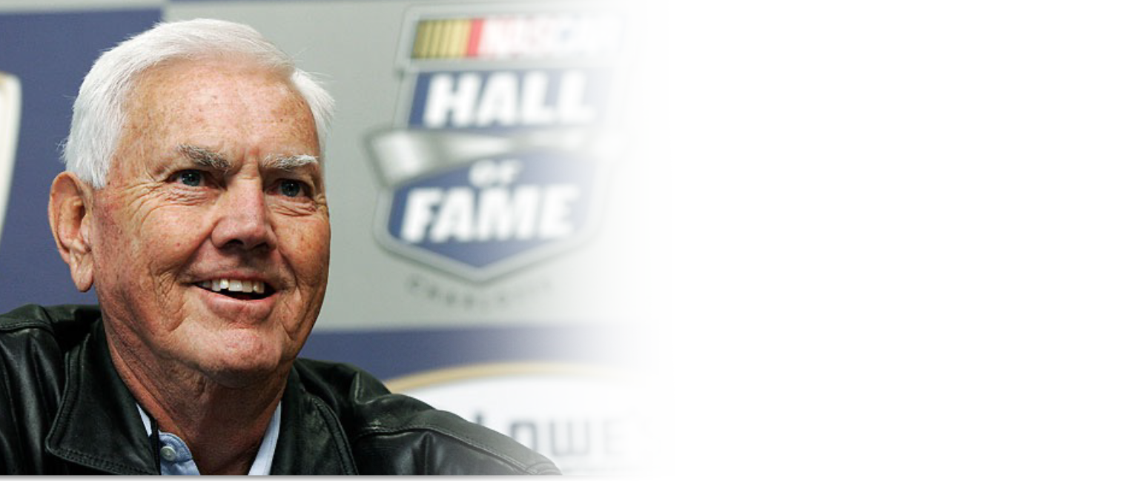
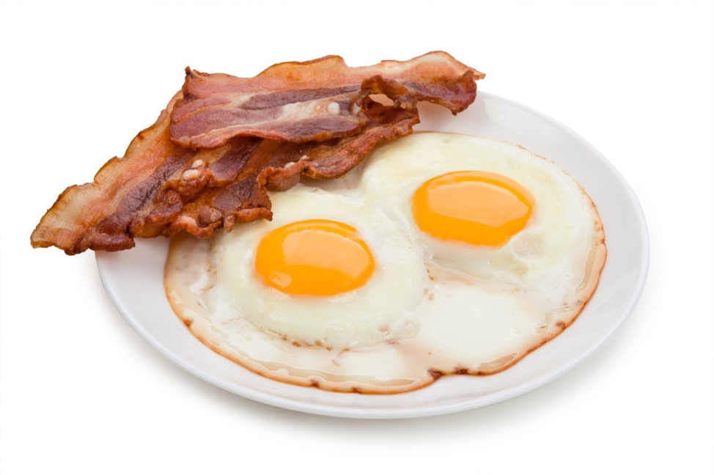
YOU HAVE A CHOICE TO MAKE!
OR AM I COMMITTED?
AM I INVOLVED?

Slide 27

LET’S CONNECT
@Mike_Mooney
@Mike_Mooney
www.MikeMooney.com
Mike@MikeMooney.com
704.361.9499
KEYNOTES • COACHING • TRAINING • CONSULTING
Presentation is confidential. 2022©, Mike Mooney, All Rights Reserved.

